Slide 1


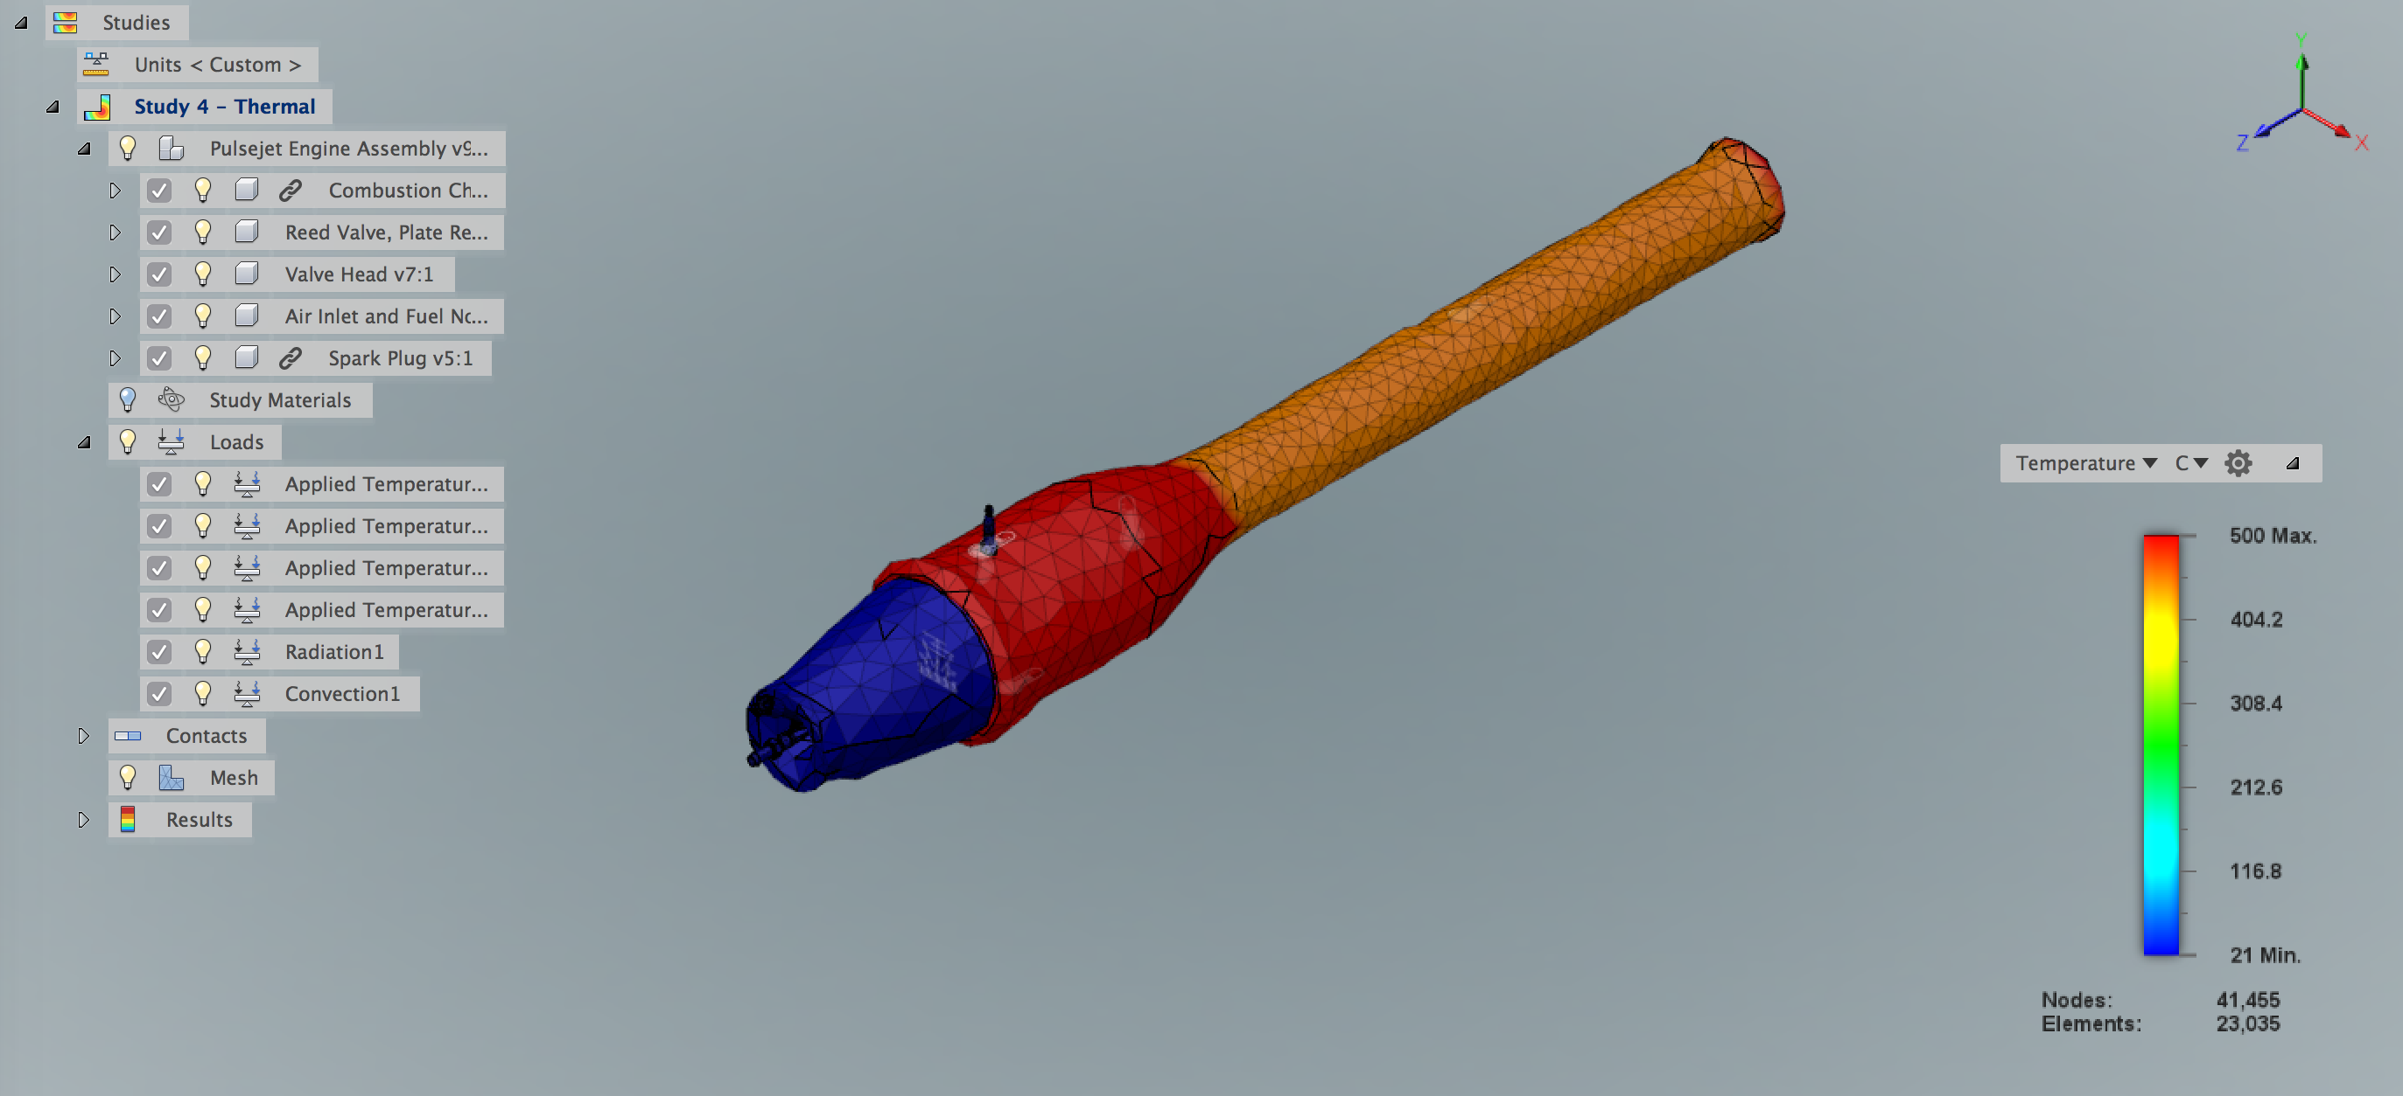
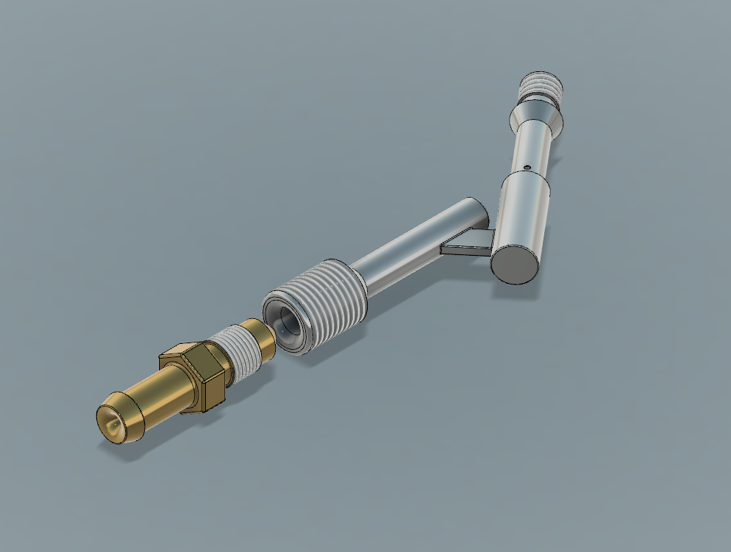
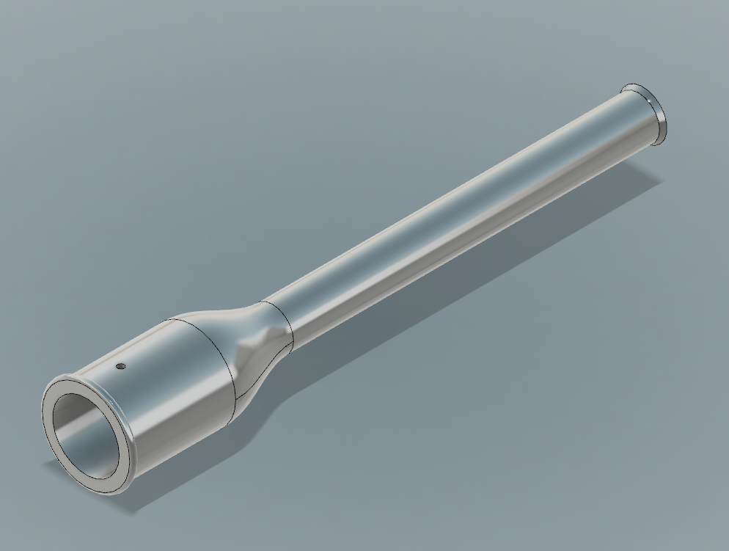
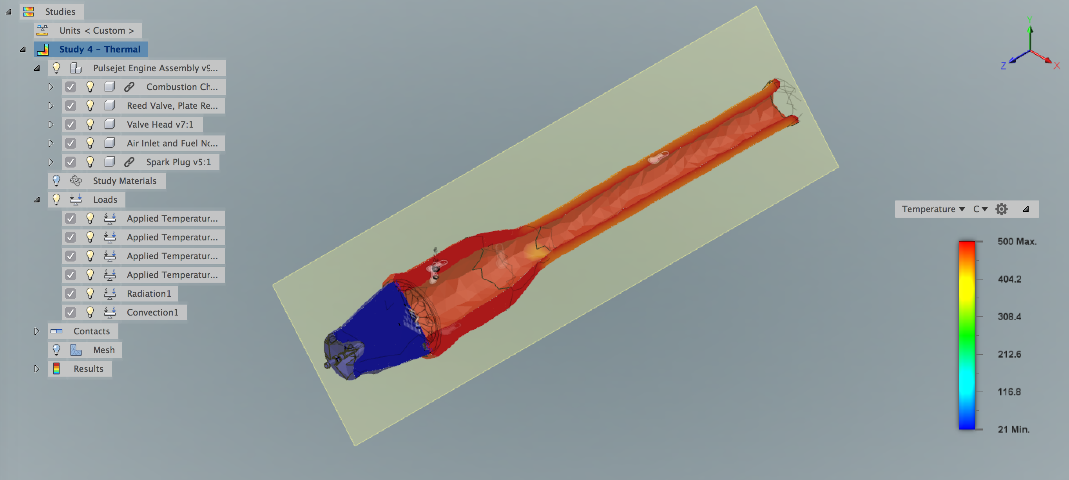
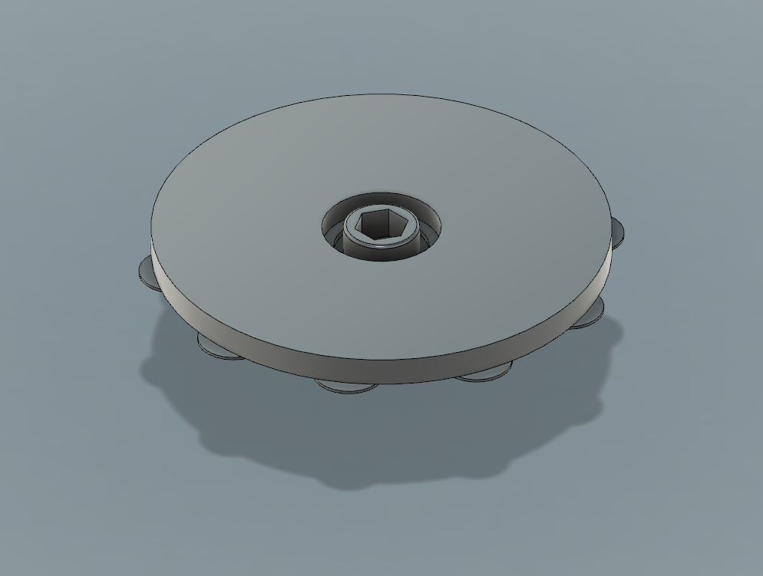
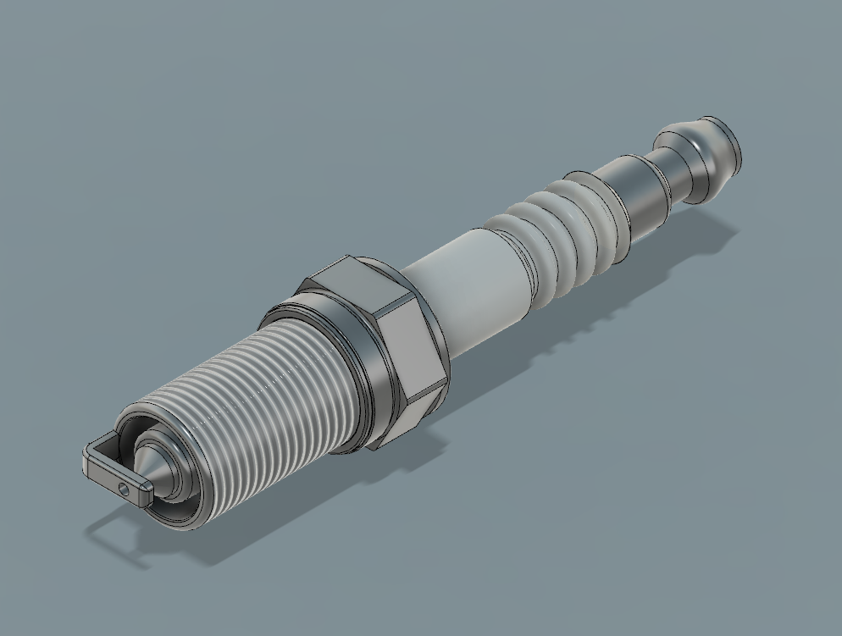
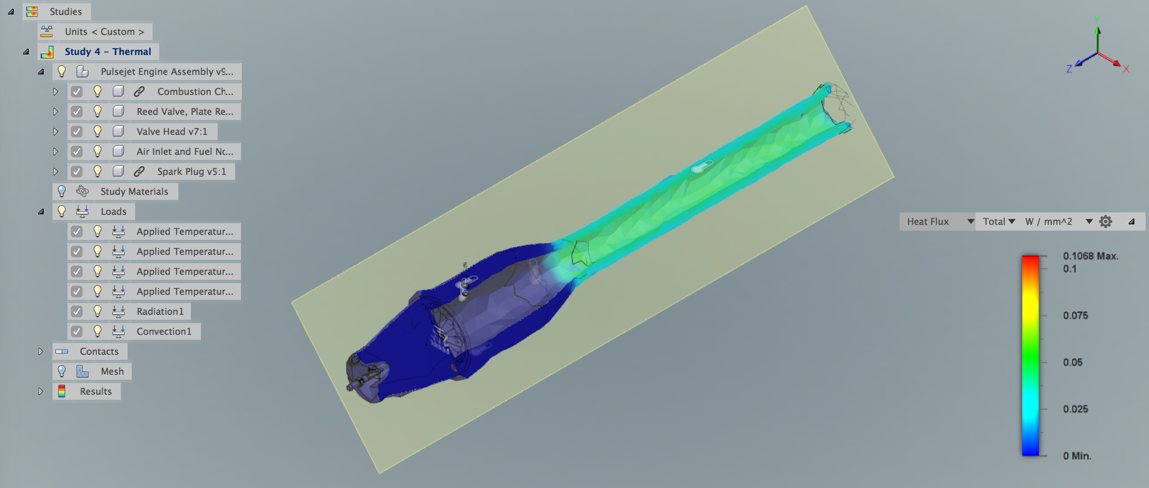
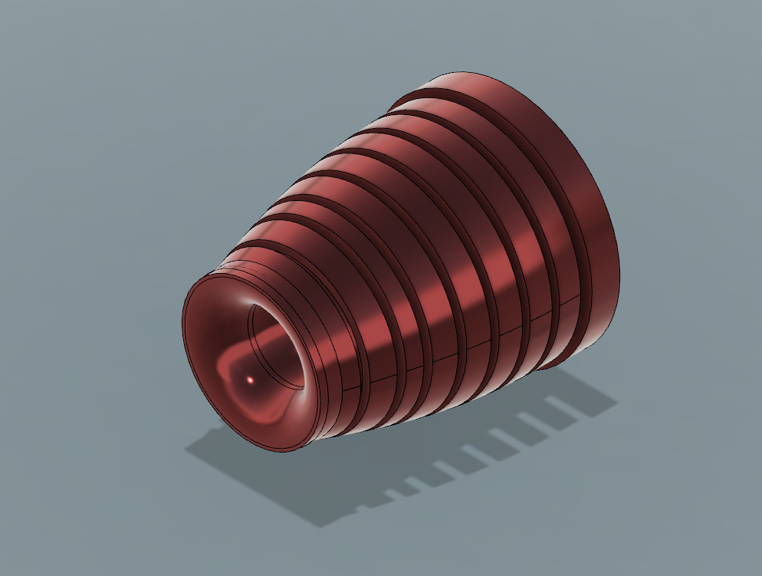
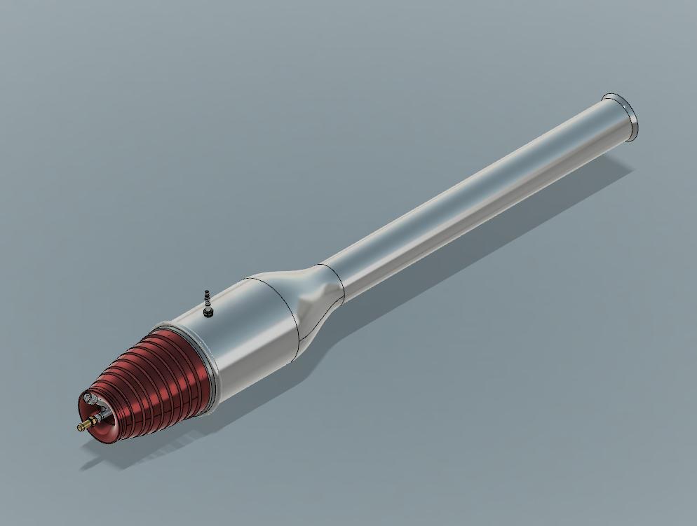
Effects of volcanic ash on pulse jet engines for small unmanned aerial systems engaged in observing volcanic activity
Jonathan Ramirez, Juan Carlos-Hernandez, Jesus Partida, Cristin Gonzalez, Joel Sumner
Mechatronics, Embedded Systems and Automation Lab
University of California, Merced / School of Engineering
Introduction
Pulsejet/Volcanic Ash Interaction
CAD Analysis
Thermal Image Rendering
Abstract: Pulse-jet engines are currently in use on small unmanned aerial systems (SUAS) used for various applications. The simplistic design and high efficiency of a pulse jet engine is ideal for a SUAS in low altitude and high speed operations, such as is necessary for the deployment of SUASs to monitor volcanic activity. However, volcanic ash containing silica, sulfuric acid and various other elements expelled from volcanic activity may prove detrimental to pulse jet engine operations. Due to its chemical properties, volcanic ash can adversely react with metallic alloys that may cause oxidation and eventually corrode these components under certain conditions. In this paper, pressure and temperature analysis will be performed on a valved pulse-jet engine exposed to volcanic ash. Computational fluid dynamics (CFD) inspection and external barometric pressure/temperature sensors will monitor the inlet and outlet of the pulse jet to determine efficiency based on experimental temperature data. Thrust capacity is measured through a real-world spring system that will correlate to Hooke’s Law and mass flow rate. Based on these factors we hope to understand how the efficiency and performance of a pulse-jet engine changes when exposed to volcanic ash, and if a pulse-jet engine would be a suitable engine for employing on a SUAS studying volcanic activity.
Experimentation of a valved pulse jet engine when exposed to volcanic ash is conducted to check optimal efficiency and overall performance. Utilizing a mechanical valve that controls the flow of expanding thrust which forces the hot gas to come out of the tailpipe while allowing air and gas through the front air intake of the engine, the overall efficiency and performance of the pulse jet engine will be determined under the effects of volcanic ash present in the atmospheric environment. Due to lack of moving parts inside the structure of the jet engine, physical/material reactions inside the jet engine will be analyzed to check if the jet engine is suitable on small unmanned aerial systems deployed for studying volcanic activity.
Volcanic ash contains elements that mainly include silica and oxygen.
The concentration of silica is dependent on the type of magma that is released during volcanic eruptions. Higher concentrations (~45-75%) are more potent to metallic alloys due to its corrosive properties.
Jet engines fail due to volcanic ash entering their internal structure. Based on the mechanisms that are at work inside them along with internal moving parts, the ash corrodes the metal alloys inside jet engines that mainly run on turbines. The oxygen accompanied reinforces corrosion due to oxidation effects and high temperature.
Pulsejet engines lack internal moving parts, consisting of only an air intake, reed valve, a combustion chamber and exhaust outlet which should not alter the interior of the engine due to only compression and combustion occurring.
In ignition stage the pulse jet was evaluated from measured temperatures of up to 500 ℃ from the combustion chamber. Below displays internal temperature distribution.
Final schematic: Pulsejet engine specifications
Heat flux distribution analysis from both external and internal components of pulse jet. Control data was collected to implement conduction and radiation measurements.
Components of pulsejet engine (from left to right): air intake and fuel nozzle, combustion chamber and exhaust pipe, reed valve and plate retainer, spark plug, valve head
Ongoing tasks include thrust velocity output measurements, metallic-oxidation analysis and resonance frequency monitoring.
Bibliography
Drexler, J. M., Gledhill, A. D., Shinoda, K., Vasiliev, A. L., Reddy, K. M., Sampath, S. and Padture, N. P. (2011), Jet Engine Coatings for Resisting Volcanic Ash Damage. Adv. Mater., 23: 2419–2424. doi:10.1002/adma.201004783
Shashank Ranjan Chaurasia, Rajesh Gupta And R.M. Sarviya (2013), Performance Analysis of a Pulsejet Engine, International Journal of Engineering Research and Applications (IJERA), Vol. 3, Issue 4,.605-609
Pulsejet engine final assembly

